Slide 1
Reimagining Inventory Management for Fashion Retail
Harvard University
IACS Capstone Project, Fall 2020
Kaivalya Rawal, Victor Sheng, Austin Rochon, William Palmer

Slide 2
Outline
Problem Description
Objective
Feature Augmentation
Forecast Modeling
Baselines
LSTM
SARIMAX
LightGBM
Optimization Problem
Takeaways

Slide 3
Problem Description

Slide 4
Motivation
Outline
Problem Description
Objective
Feature Augmentation
Forecast Modeling
Baselines
LSTM
SARIMAX
LightGBM
Optimization
Takeaways
“I’m sorry, but we don’t have that item in stock. It may be available at our other stores.”

Slide 5
Project Goals
Outline
Problem Description
Objective
Feature Augmentation
Forecast Modeling
Baselines
LSTM
SARIMAX
LightGBM
Optimization
Takeaways
Syrup.tech: inventory management for fashion retail
Primary goal: forecast sales, optimize inventory across stores
Forecast
Optimize

Slide 6
Data Sources
Outline
Problem Description
Objective
Feature Augmentation
Forecast Modeling
Baselines
LSTM
SARIMAX
LightGBM
Optimization
Takeaways
1 European fashion retailer
Product Attributes (“master data”):
Detailed product information of all unique articles of clothing since 2017
Inventory:
Historical (3 year) dataset of inventory levels (excluding sizes)
Real-time snapshots of inventory (including sizes)
Transactions
Historical (3 year) dataset of transaction records

Slide 7
Novelty of Problem / Challenges
Outline
Problem Description
Objective
Feature Augmentation
Forecast Modeling
Baselines
LSTM
SARIMAX
LightGBM
Optimization
Takeaways
Number of groupings
Over 100K unique articles
50 unique stores
“Sparseness” of data
On a weekly basis, we may only have 1 or 2 sales per article, per store
Clothing articles have a short life span and thus limited sales history
Tricky evaluation metric
Given our end objective (optimizing inventory), our evaluation metric is more complicated than simple MSE

Slide 8
Objective

Slide 9
Metric ←→ Business objective
Outline
Problem Description
Objective
Feature Augmentation
Forecast Modeling
Baselines
LSTM
SARIMAX
LightGBM
Optimization
Takeaways
Objective : Maximize profit by allocating inventory that will be sold in the next week.
2 Consequences : We pay more attention to :
Expensive articles
Articles that have high variance of inventory across stores

Slide 10
Metric ←→ Business objective
Outline
Problem Description
Objective
Feature Augmentation
Forecast Modeling
Baselines
LSTM
SARIMAX
LightGBM
Optimization
Takeaways

Slide 11
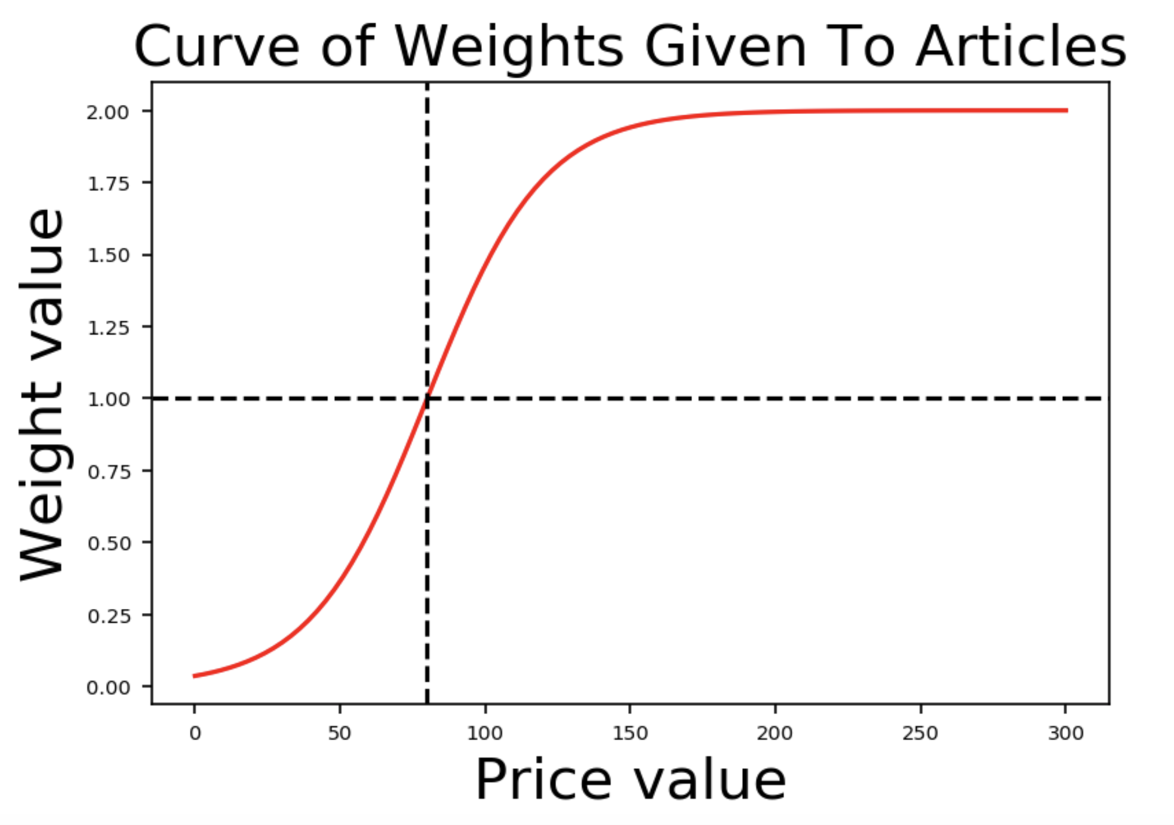
Metric ←→ Business objective
Outline
Problem Description
Objective
Feature Augmentation
Forecast Modeling
Baselines
LSTM
SARIMAX
LightGBM
Optimization
Takeaways

Slide 12
Feature Augmentation

Slide 13
Weather Data
Outline
Problem Description
Objective
Feature Augmentation
Forecast Modeling
Baselines
LSTM
SARIMAX
LightGBM
Optimization
Takeaways
Affects Sales

Slide 14
Forecast
Modeling

Slide 15
Baseline
Outline
Problem Description
Objective
Feature Augmentation
Forecast Modeling
Baselines
LSTM
SARIMAX
LightGBM
Optimization
Takeaways
Naive Baseline: sales forecast for next week is assumed to be equal to the observed sales for this week (no model training!)

Slide 16
Baseline: Results
Outline
Problem Description
Objective
Feature Augmentation
Forecast Modeling
Baselines
LSTM
SARIMAX
LightGBM
Optimization
Takeaways
Evaluation: common test set created to compare models
Model | Naive baseline
wMSE | 1.89
MSE | 2.15
wMAE | 0.87
MAE | 0.84
wR² | -0.55
R² | 0.01

Slide 17
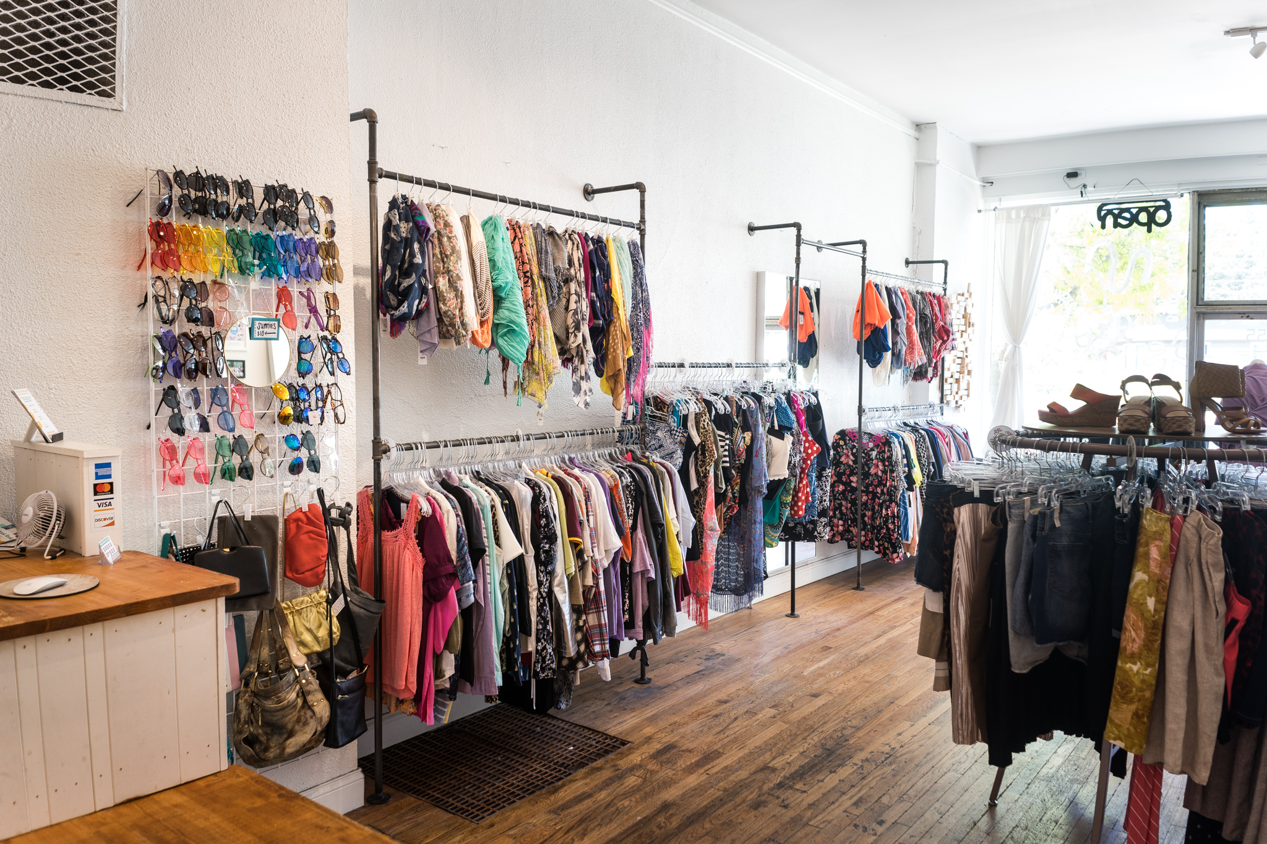
LSTM: Features
Outline
Problem Description
Objective
Feature Augmentation
Forecast Modeling
Baselines
LSTM
SARIMAX
LightGBM
Optimization
Takeaways
Article attributes
Store attributes
Dates
Sales
Weather

Slide 18
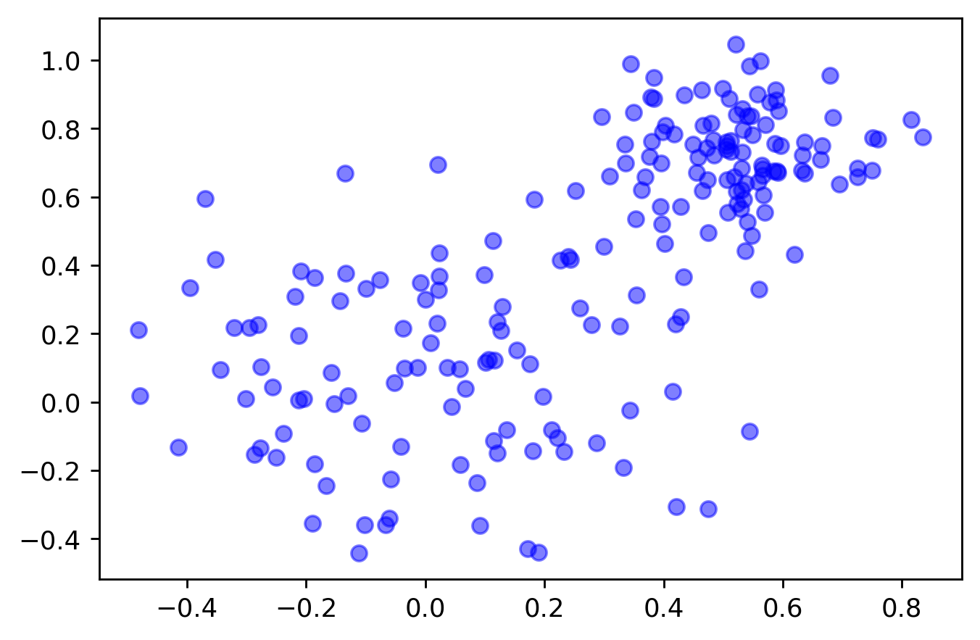
LSTM: Embeddings
Outline
Problem Description
Objective
Feature Augmentation
Forecast Modeling
Baselines
LSTM
SARIMAX
LightGBM
Optimization
Takeaways
Hugo Boss dark blue jeans
Rag & Bone
light blue
wash jeans
Tommy Bahama floral print Hawaiian shirt

Slide 19
LSTM: Models
Outline
Problem Description
Objective
Feature Augmentation
Forecast Modeling
Baselines
LSTM
SARIMAX
LightGBM
Optimization
Takeaways
Simple univariate LSTM: Only past sales as predictor
Full predictor set LSTM: All available predictors less weather
Full predictor set + weather LSTM: All predictors + weather data

Slide 20
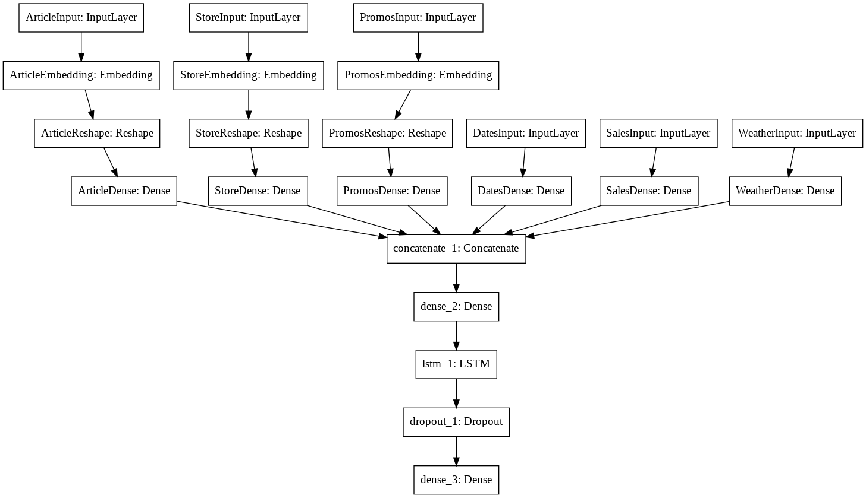
LSTM: Architecture
Outline
Problem Description
Objective
Feature Augmentation
Forecast Modeling
Baselines
LSTM
SARIMAX
LightGBM
Optimization
Takeaways

Slide 21
LSTM: Performance
Outline
Problem Description
Objective
Feature Augmentation
Forecast Modeling
Baselines
LSTM
SARIMAX
LightGBM
Optimization
Takeaways
Total Size = ~14 MB
Data preparation time: ~30 mins
Training time: ~30 mins
Model | Naive baseline | LSTM (historical sales only) | LSTM (full feature set) | LSTM (full feature set + weather)
wMSE | 1.89 | 1.48 | 1.56 | 1.46
MSE | 2.15 | 1.52 | 1.60 | 1.51
wMAE | 0.87 | 1.02 | 1.05 | 1.01
MAE | 0.84 | 1.02 | 1.06 | 1.01
wR² | -0.55 | -1.75 | -1.89 | -1.74
R² | 0.01 | -1.45 | -1.66 | -1.43

Slide 22
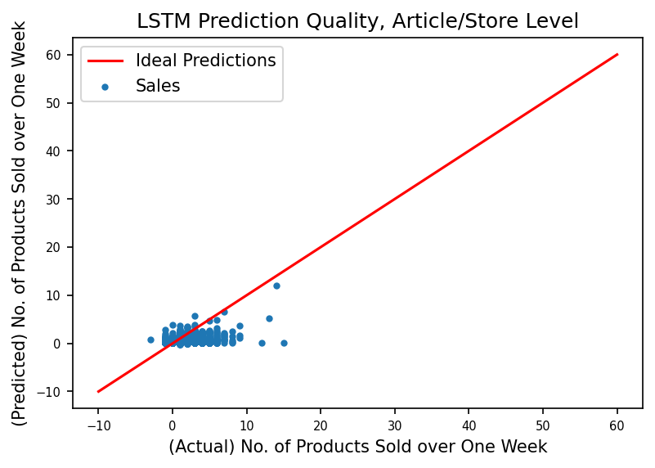
LSTM: Performance
Outline
Problem Description
Objective
Feature Augmentation
Forecast Modeling
Baselines
LSTM
SARIMAX
LightGBM
Optimization
Takeaways

Slide 23
SARIMAX
Outline
Problem Description
Objective
Feature Augmentation
Forecast Modeling
Baselines
LSTM
SARIMAX
LightGBM
Optimization
Takeaways
SARIMAX: Seasonal AutoRegressive Integrated Moving Averages with eXogenous regressors …
… a lot of words!

Slide 24
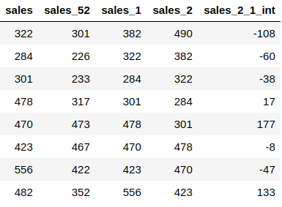
SARIMAX: time-series view
Outline
Problem Description
Objective
Feature Augmentation
Forecast Modeling
Baselines
LSTM
SARIMAX
LightGBM
Optimization
Takeaways
Hypothetical time-series prediction task

Slide 25
SARIMAX: ML view
Outline
Problem Description
Objective
Feature Augmentation
Forecast Modeling
Baselines
LSTM
SARIMAX
LightGBM
Optimization
Takeaways
Hypothetical machine learning task
Y
X

Slide 26
SARIMAX: time-series to ML
Outline
Problem Description
Objective
Feature Augmentation
Forecast Modeling
Baselines
LSTM
SARIMAX
LightGBM
Optimization
Takeaways
What is ‘X’ for the time series?
???

Slide 27
SARIMAX: Feature Engineering
Outline
Problem Description
Objective
Feature Augmentation
Forecast Modeling
Baselines
LSTM
SARIMAX
LightGBM
Optimization
Takeaways
Seasonal

Slide 28
SARIMAX: Feature Engineering
Outline
Problem Description
Objective
Feature Augmentation
Forecast Modeling
Baselines
LSTM
SARIMAX
LightGBM
Optimization
Takeaways
AutoRegressive

Slide 29
SARIMAX: Feature Engineering
Outline
Problem Description
Objective
Feature Augmentation
Forecast Modeling
Baselines
LSTM
SARIMAX
LightGBM
Optimization
Takeaways
AutoRegressive

Slide 30
SARIMAX: Feature Engineering
Outline
Problem Description
Objective
Feature Augmentation
Forecast Modeling
Baselines
LSTM
SARIMAX
LightGBM
Optimization
Takeaways
AutoRegressive

Slide 31
SARIMAX: Feature Engineering
Outline
Problem Description
Objective
Feature Augmentation
Forecast Modeling
Baselines
LSTM
SARIMAX
LightGBM
Optimization
Takeaways
Integrated
- =
- =
- =
- =
- =
- =
- =
- =

Slide 32
SARIMAX: Feature Engineering
Outline
Problem Description
Objective
Feature Augmentation
Forecast Modeling
Baselines
LSTM
SARIMAX
LightGBM
Optimization
Takeaways
Complete Design Matrix ‘X’
Y
X

Slide 33
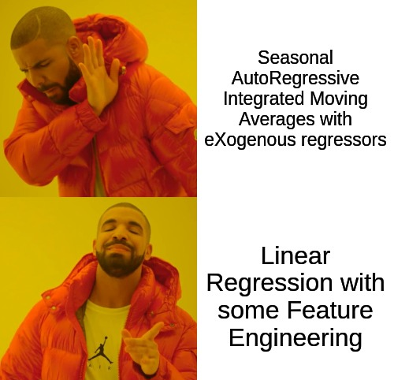
SARIMAX: Feature Engineering
Outline
Problem Description
Objective
Feature Augmentation
Forecast Modeling
Baselines
LSTM
SARIMAX
LightGBM
Optimization
Takeaways

Slide 34
SARIMAX: Problems
Outline
Problem Description
Objective
Feature Augmentation
Forecast Modeling
Baselines
LSTM
SARIMAX
LightGBM
Optimization
Takeaways
Complete Design Matrix ‘X’
Y
X

Slide 35
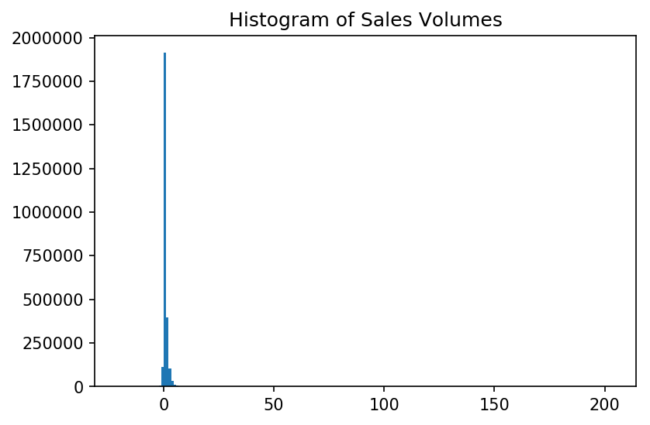
SARIMAX: Problems
Outline
Problem Description
Objective
Feature Augmentation
Forecast Modeling
Baselines
LSTM
SARIMAX
LightGBM
Optimization
Takeaways

Slide 36
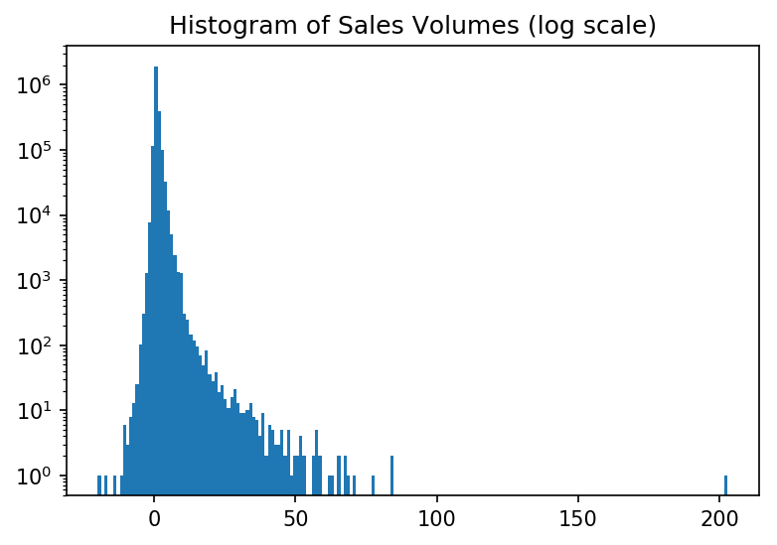
SARIMAX: Problems
Outline
Problem Description
Objective
Feature Augmentation
Forecast Modeling
Baselines
LSTM
SARIMAX
LightGBM
Optimization
Takeaways

Slide 37
SARIMAX: 2 Key Observations
Outline
Problem Description
Objective
Feature Augmentation
Forecast Modeling
Baselines
LSTM
SARIMAX
LightGBM
Optimization
Takeaways
High sales for one item should mean high sales for similar items
That is, sales of related items should inform future sales predictions

Slide 38
SARIMAX: 2 Key Observations
Outline
Problem Description
Objective
Feature Augmentation
Forecast Modeling
Baselines
LSTM
SARIMAX
LightGBM
Optimization
Takeaways
High sales for one item should mean high sales for similar items
That is, sales of related items should inform future sales predictions
Items sell infrequently
Max. weekly sales for individual articles usually 0 or 1
Terrible Baseline R²

Slide 39
SARIMAX: Solution
Outline
Problem Description
Objective
Feature Augmentation
Forecast Modeling
Baselines
LSTM
SARIMAX
LightGBM
Optimization
Takeaways
Perform the predictions on article-features, instead of articles.
Instead of predicting the sales of Drake’s jacket *
Predict the sales of Orange Jackets in general:
Forecast separately the sales of all orange clothing, and separately the sales of all jackets
And then use these 2 forecasts to predict the sales for Drake’s favourite jacket
* Drake’s favourite Jacket:

Slide 40
Modified SARIMAX
Outline
Problem Description
Objective
Feature Augmentation
Forecast Modeling
Baselines
LSTM
SARIMAX
LightGBM
Optimization
Takeaways
Two step process:
Forecast - Predict feature level sales (Ridge regression):
Color: Orange
Category: Outerwear
Category - detail: Jacket
Segment: Men
Nowcast - Predict article level sales using the predictions from step one (Random Forest)

Slide 41
Modified SARIMAX: Results
Outline
Problem Description
Objective
Feature Augmentation
Forecast Modeling
Baselines
LSTM
SARIMAX
LightGBM
Optimization
Takeaways
Total Size = ~6 MB
Data preparation time: ~10 mins
Training time: ~10 mins
Model | Basic baseline | Modified SARIMAX
wMSE | 1.89 | 0.92
MSE | 2.15 | 0.93
wMAE | 0.87 | 0.50
MAE | 0.84 | 0.51
wR² | -0.55 | 0.09
R² | 0.01 | 0.08

Slide 42
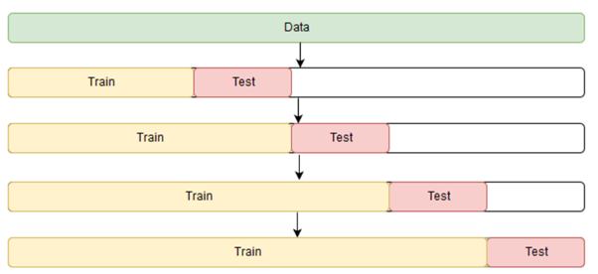
LightGBM: Ideation
Outline
Problem Description
Objective
Feature Augmentation
Forecast Modeling
Baselines
LSTM
SARIMAX
LightGBM
Optimization
Takeaways
Use lagged versions of average sales directly at a product attribute & store level, which removes reliance on SARIMAX outputs
Use a product’s historical sales from the last 4 weeks
Use all available product attributes from catalog data
Tune hyperparameters using time series cross-validation splits

Slide 43
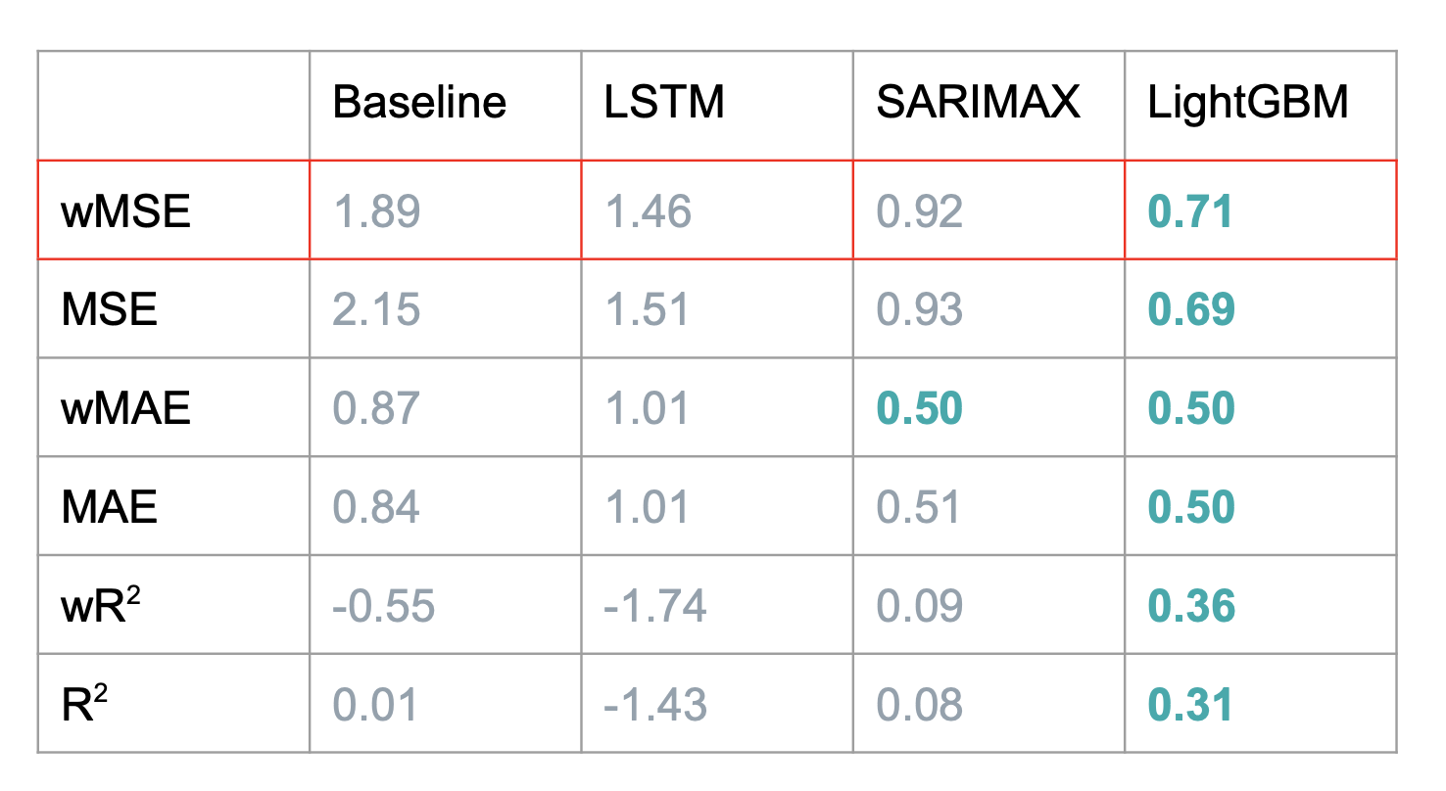
LightGBM: Performance
Outline
Problem Description
Objective
Feature Augmentation
Forecast Modeling
Baselines
LSTM
SARIMAX
LightGBM
Optimization
Takeaways
Size: ~70 MB
Data preparation time: ~15 min
Training time: ~2 min

Slide 44
Optimization
Problem

Slide 45
Optimization
Outline
Problem Description
Objective
Feature Augmentation
Forecast Modeling
Baselines
LSTM
SARIMAX
LightGBM
Optimization
Takeaways
Inventory level At Start of the Week
Forecast Of Sales for Next Week

Slide 46
Optimization
Outline
Problem Description
Objective
Feature Augmentation
Forecast Modeling
Baselines
LSTM
SARIMAX
LightGBM
Optimization
Takeaways
Inventory level At Start of the Week
Forecast Of Sales for Next Week

Slide 47
Optimization
Outline
Problem Description
Objective
Feature Augmentation
Forecast Modeling
Baselines
LSTM
SARIMAX
LightGBM
Optimization
Takeaways
Inventory level At Start of the Week
Forecast Of Sales for Next Week
Shift

Slide 48
Optimization
Outline
Problem Description
Objective
Feature Augmentation
Forecast Modeling
Baselines
LSTM
SARIMAX
LightGBM
Optimization
Takeaways
Inventory level At Start of the Week
Forecast Of Sales for Next Week
Shift
Objective :
Increase the “Safety Net”
MAX for every store
for every article
for every size
-

Slide 49
Mixed Integer Linear Programming
Outline
Problem Description
Objective
Feature Augmentation
Forecast Modeling
Baselines
LSTM
SARIMAX
LightGBM
Optimization
Takeaways

Slide 50
Mixed Integer Linear Programming
Outline
Problem Description
Objective
Feature Augmentation
Forecast Modeling
Baselines
LSTM
SARIMAX
LightGBM
Optimization
Takeaways
“Safety Net”

Slide 51
Mixed Integer Linear Programming
Outline
Problem Description
Objective
Feature Augmentation
Forecast Modeling
Baselines
LSTM
SARIMAX
LightGBM
Optimization
Takeaways
Define Constraints :
No new Inventory
An item cannot change size while being moved around

Slide 52
Mixed Integer Linear Programming
Outline
Problem Description
Objective
Feature Augmentation
Forecast Modeling
Baselines
LSTM
SARIMAX
LightGBM
Optimization
Takeaways
Define Constraints :
No new Inventory
An item cannot change size while being moved around
What about the retailer preferences ?
Is he averse to shifts ?
Is he unbothered by article sizes missing in some stores ?

Slide 53
Mixed Integer Linear Programming
Outline
Problem Description
Objective
Feature Augmentation
Forecast Modeling
Baselines
LSTM
SARIMAX
LightGBM
Optimization
Takeaways

Slide 54
Mixed Integer Linear Programming
Outline
Problem Description
Objective
Feature Augmentation
Forecast Modeling
Baselines
LSTM
SARIMAX
LightGBM
Optimization
Takeaways

Slide 55
Mixed Integer Linear Programming
Outline
Problem Description
Objective
Feature Augmentation
Forecast Modeling
Baselines
LSTM
SARIMAX
LightGBM
Optimization
Takeaways
Advantages :
Automatic Process
Linear Optimization ←→ Fast run-time
Change Weights Based on Clients Preference
Drawbacks :
No control on the Variance of sizes across stores
No Evaluation of Efficiency of the Shifts

Slide 56
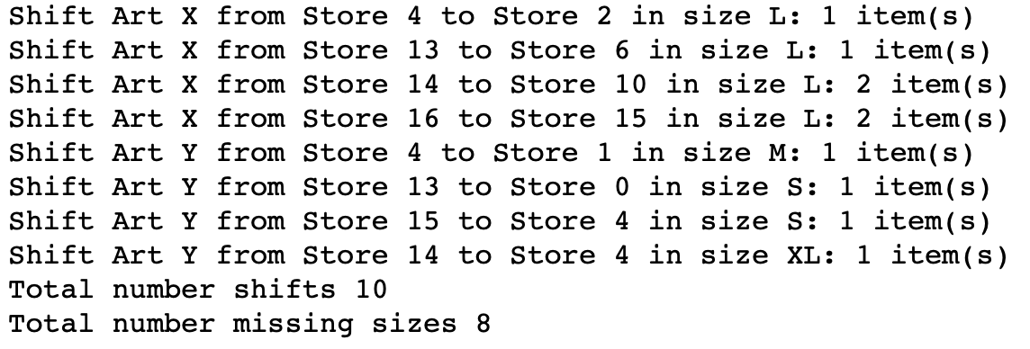
End-Product
Outline
Problem Description
Objective
Feature Augmentation
Forecast Modeling
Baselines
LSTM
SARIMAX
LightGBM
Optimization
Takeaways
Article X
Article Y
Article Z

Slide 57
Takeaways

Slide 58
Takeaways
Linear optimization is promising
Effective at optimizing inventory allocation
Can Incorporate Constraints and Tailor to Preferences
Did not solve the “missing counterfactuals” problem
Although linear optimization provided for an effective method to allocate inventory, we still were not able to evaluate the efficiency of the shifts
“Sparseness of data” was an issue, particularly with LSTMs
Low frequency and high frequency subsets of article/store level sales affected LSTM performance
Future work: split LSTM into two models
Outline
Problem Description
Objective
Feature Augmentation
Forecast Modeling
Baselines
LSTM
SARIMAX
LightGBM
Optimization
Takeaways

Slide 59
Questions?

Slide 60
Reimagining Inventory Management for Fashion Retail
Kaivalya Rawal | Austin Rochon | Victor Sheng | William Palmer
PROBLEM
Fashion retailers constantly reallocate inventory, but they cannot determine optimal allocations. Maximise profits by accurately forecasting sales. Prevent stock-outs by optimising product reallocations based on sales-inventory gaps.
DATA
Historical Sales
Historical Inventory Levels
Article Attributes (Color/Brand/Product Type...)
Weather Data (Temperature, Snow, Wind…)
OBJECTIVE
FORECASTING
Baseline: simple baseline that predicts next period’s sales to be the same as the previous period’s sales
LSTM: long short-term memory network with embeddings for categorical features and augmented weather data
SARIMAX: Feature-wise time-series prediction, followed by random-forest aggregation
LightGBM: gradient-boosted trees using lagged product and product-attribute-level sales
OPTIMIZATION
Used Mixed Integer Linear Programming at a Size/Article/Store level
With I inventory level, F forecasted sales,
S number of shifts, M number of missing sizes
CONTRIBUTIONS
Designed custom metric, specific to business use case
Augmented predictors with alternate data sources
Built LSTM to perform time-series forecast for weekly article/store level sales. Incorporated embedding layers to represent categorical features and used augmented weather data
Modified SARIMAX time series modelling on feature level data to predict sales for articles without sales histories
Built LightGBM model that performs best out of all approaches tried
Used Linear Constraint Optimization with regularization to limit the number of shifts and the number of missing sizes.
Historical Sales
Forecast
Optimize
Recommend Shifts

