Slide 1
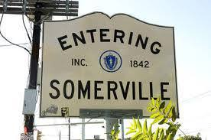
Uniting Somerville’s Tree Inventory Datasets for Tree Growth and Survival Analysis

Slide 2
Why are trees so important?
Moderate the temperature
Increase happiness
Provide habitats for wildlife
Prevent erosion
Increase property values
Improve health
Reduce stormwater runoff and water pollution
Lower levels of urban pollutants

Slide 3
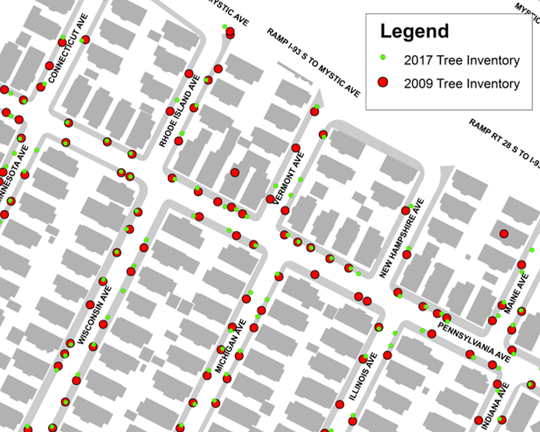
What are we trying to achieve?
Primary Goal:
Unite Tree Inventory Datasets
Answer Question: Which trees to plant where?
Survival analysis and predictive modeling
Which types of trees will survive the longest in a given location?
Provide Added Value: Automation & Insights
Tree inventories cost the city around $100K each
Can we partially automate this process?
Can we provide insights on the best way to direct resources?

Slide 4
What data do we have access to?
Tree inventories
~ 2009 - parks and streets
~ 2017 - total city wide
Notes:
So what data do we have currently?
Two tree inventories performed almost 10 years apart - data was collected manually by certified arborists
We have over 12,000 and 15,000 unique trees in each dataset respectively with a total species diversity of over 160
Contained within these datasets are useful information at a unique tree level, including:
The location of the tree (not 100% accurate)
The Diameter at breast height (4.5 feet off the ground)
Any issues with the tree’s health
Recommendations for removal or treatments

Slide 5
What data do we have access to?
Tree inventories
~ 2009 - parks and streets
~ 2017 - total city wide
Data volume
12,000 unique trees in 2009
15,000 unique trees in 2017
Over 160 different species across Somerville
Notes:
So what data do we have currently?
Two tree inventories performed almost 10 years apart - data was collected manually by certified arborists
We have over 12,000 and 15,000 unique trees in each dataset respectively with a total species diversity of over 160
Contained within these datasets are useful information at a unique tree level, including:
The location of the tree (not 100% accurate)
The Diameter at breast height (4.5 feet off the ground)
Any issues with the tree’s health
Recommendations for removal or treatments

Slide 6
What data do we have access to?
Tree inventories
~ 2009 - parks and streets
~ 2017 - total city wide
Data volume
12,000 unique trees in 2009
15,000 unique trees in 2017
Over 160 different species across Somerville
Key information
Lat/Long coordinates (accuracy varies)
DBH (size of the trees)
Health & condition
Expert recommendations
Notes:
So what data do we have currently?
Two tree inventories performed almost 10 years apart - data was collected manually by certified arborists
We have over 12,000 and 15,000 unique trees in each dataset respectively with a total species diversity of over 160
Contained within these datasets are useful information at a unique tree level, including:
The location of the tree (not 100% accurate)
The Diameter at breast height (4.5 feet off the ground)
Any issues with the tree’s health
Recommendations for removal or treatments

Slide 7
What you didn’t know about Somerville trees
Cherry Trees
Cherry Plum sees the highest increase
Japanese Flowering Cherry sees the second highest decrease
Notes:
So what does all this data mean to us?
We can use it to infer interest trends and facts over time
For example:
Cherry Trees show the highest increase/decrease
The largest tree is a Silver Maple
There has been a sharp increase in the number of recorded stumps
Once we delve deeper we hope to understand these trends in more detail, why they are the case and uncover insights for future decision making

Slide 8
What you didn’t know about Somerville trees
Silver Maple
Largest tree (by DBH) existing in Somerville
Can be found at a secret location in West Somerville
Cherry Trees
Cherry Plum sees the highest increase
Japanese Flowering Cherry sees the second highest decrease
Notes:
So what does all this data mean to us?
We can use it to infer interest trends and facts over time
For example:
Cherry Trees show the highest increase/decrease
The largest tree is a Silver Maple
There has been a sharp increase in the number of recorded stumps
Once we delve deeper we hope to understand these trends in more detail, why they are the case and uncover insights for future decision making

Slide 9
What you didn’t know about Somerville trees
Silver Maple
Largest tree (by DBH) existing in Somerville
Can be found at a secret location in West Somerville
Cherry Trees
Cherry Plum sees the highest increase
Japanese Flowering Cherry sees the second highest decrease
Stumps
Sharp increase in the number of recorded stumps from 2009 to 2017
Notes:
So what does all this data mean to us?
We can use it to infer interest trends and facts over time
For example:
Cherry Trees show the highest increase/decrease
The largest tree is a Silver Maple
There has been a sharp increase in the number of recorded stumps
Once we delve deeper we hope to understand these trends in more detail, why they are the case and uncover insights for future decision making

Slide 10
How do we plan to approach the project?
Primary task
Harmonize datasets: Using matching heuristics and unsupervised models, identify trees that appear in both datasets in order to get a unified inventory.
Enhance the matching process with external data: Using remote sensing (satellite) and administrative (public works requests, etc.) data, build models that help improve and/or ground-truth the matches (e.g. train a model that identifies whether or not an emplacement contains a tree).
Provide tools for continuous data coverage:
Using external data that is continuously available, provide ways of filling gaps in the tree inventory between censuses (e.g. satellite-based indicator of whether canopy is growing or shrinking year-to-year in each zone).
2009
Satellite images, 311 requests, etc.
2017
Cross-temporal tree inventory
Stretch goal
Build forecasting tools: Build models using the combined data to forecast KPIs (survival rate, growth rate, maintenance cost, ...) for various subgroups of interest (species, neighborhood, care regimen, ...).
2009
2017
20??

Slide 11
Thank you!
Exiting

