Slide 1
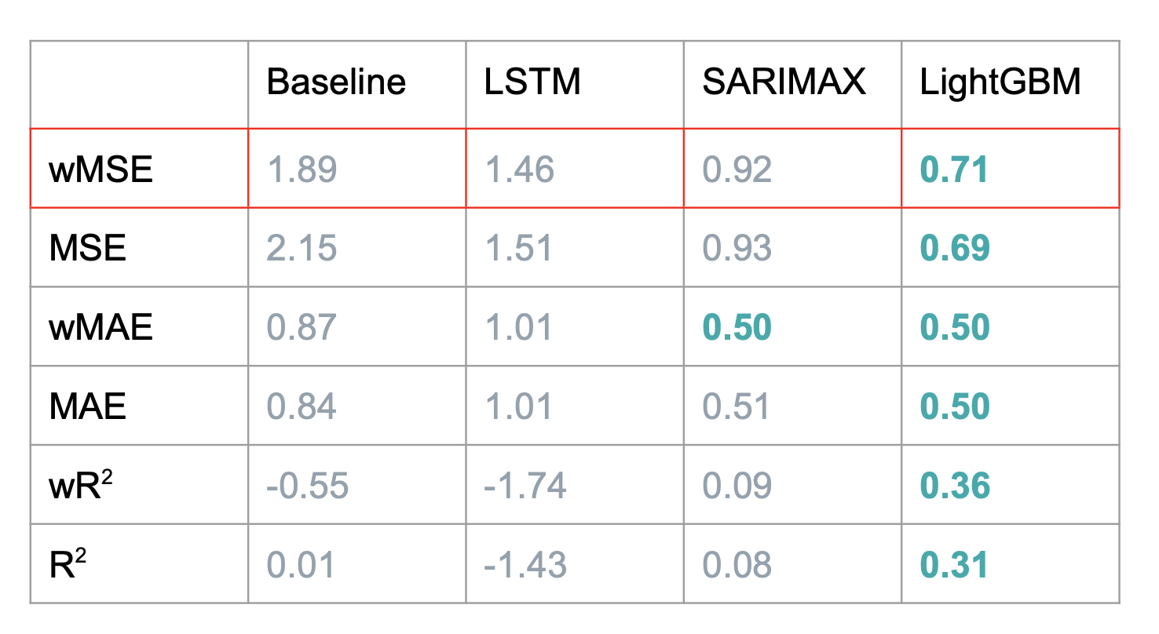
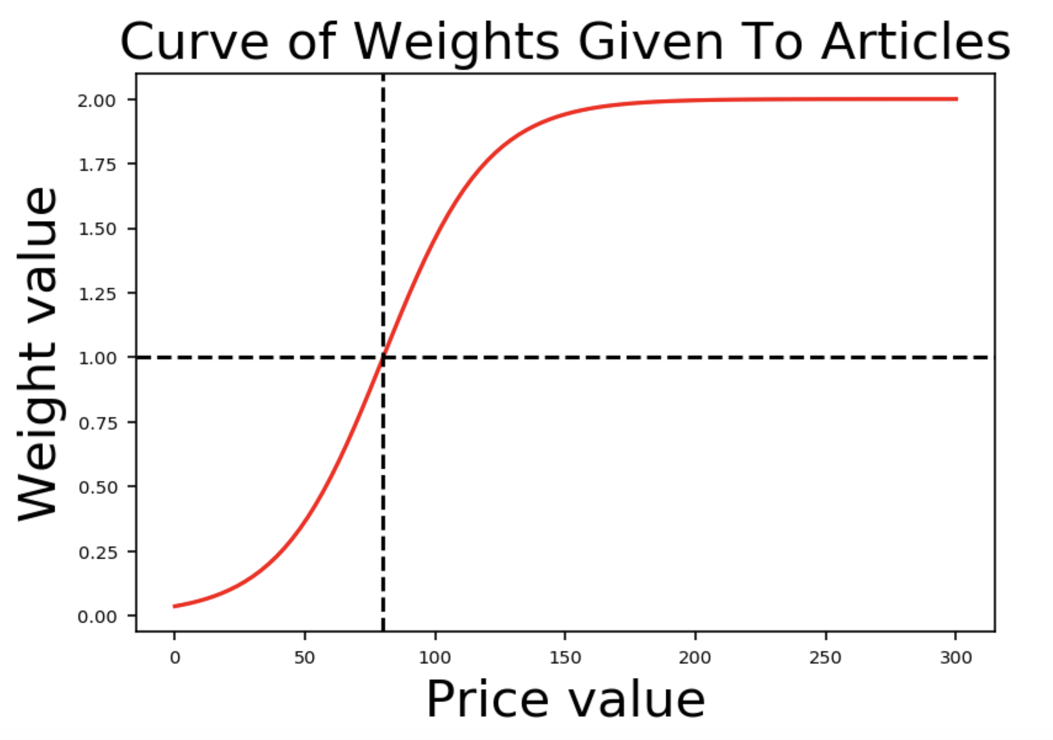
Reimagining Inventory Management for Fashion Retail
Kaivalya Rawal | Austin Rochon | Victor Sheng | William Palmer
PROBLEM
Fashion retailers constantly reallocate inventory, but they cannot determine optimal allocations. Maximise profits by accurately forecasting sales. Prevent stock-outs by optimising product reallocations based on sales-inventory gaps.
DATA
Historical Sales
Historical Inventory Levels
Article Attributes (Color/Brand/Product Type...)
Weather Data (Temperature, Snow, Wind…)
OBJECTIVE
FORECASTING
Baseline: simple baseline that predicts next period’s sales to be the same as the previous period’s sales
LSTM: long short-term memory network with embeddings for categorical features and augmented weather data
SARIMAX: Feature-wise time-series prediction, followed by random-forest aggregation
LightGBM: gradient-boosted trees using lagged product and product-attribute-level sales
OPTIMIZATION
Used Mixed Integer Linear Programming at a Size/Article/Store level
With I inventory level, F forecasted sales,
S number of shifts, M number of missing sizes
CONTRIBUTIONS
Designed custom metric, specific to business use case
Augmented predictors with alternate data sources
Built LSTM to perform time-series forecast for weekly article/store level sales. Incorporated embedding layers to represent categorical features and used augmented weather data
Modified SARIMAX time series modelling on feature level data to predict sales for articles without sales histories
Built LightGBM model that performs best out of all approaches tried
Used Linear Constraint Optimization with regularization to limit the number of shifts and the number of missing sizes.
Historical Sales
Forecast
Optimize
Recommend Shifts

Slide 2
 | Baseline | LSTM | SARIMAX | LightGBM
wMSE | 1.89 | 1.46 | 0.92 | 0.71
MSE | 2.15 | 1.51 | 0.93 | 0.69
wMAE | 0.87 | 1.01 | 0.50 | 0.50
MAE | 0.84 | 1.01 | 0.51 | 0.50
wR² | -0.55 | -1.74 | 0.09 | 0.36
R² | 0.01 | -1.43 | 0.08 | 0.31

Slide 3
 | Baseline | SYRUP | LSTM | SARIMAX | LightGBM
wMSE | 1.89 | 0.77 | 1.46 | 0.92 | 0.71
MSE | 2.15 | 0.86 | 1.51 | 0.93 | 0.69
wMAE | 0.87 | 0.56 | 1.01 | 0.50 | 0.50
MAE | 0.84 | 0.60 | 1.01 | 0.51 | 0.50
wR² | -0.55 | -0.21 | -1.74 | 0.09 | 0.36
R² | 0.01 | 0.23 | -1.43 | 0.08 | 0.31

Slide 4
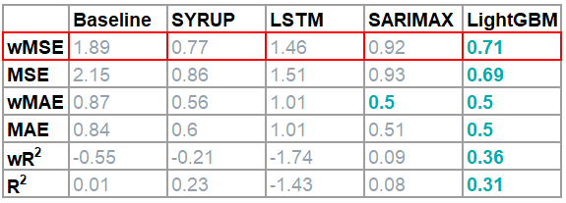
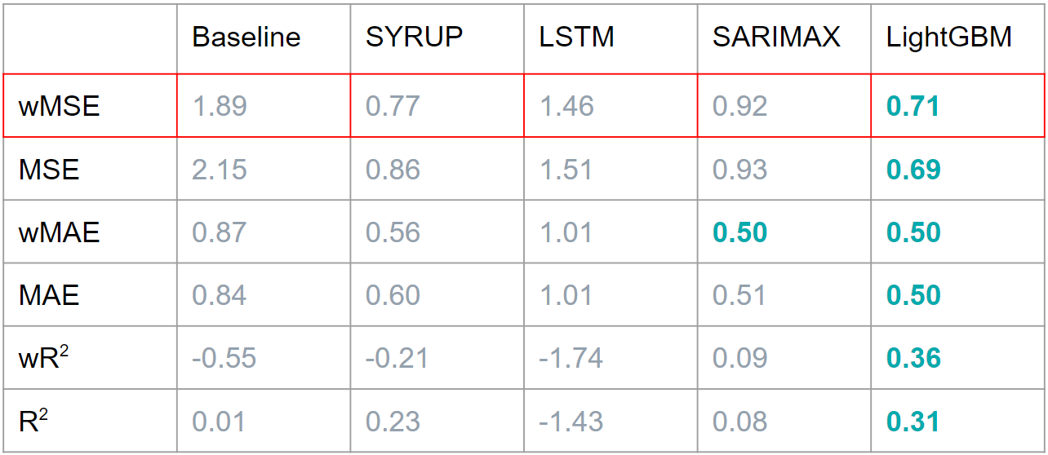
Historical Sales
Forecast
Optimise
Recommend Shifts
Sales Forecast
Inventory Optimization
Shifts Recommendation
Historical
Sales
Forecast
Optimise
Recommend Shifts
Historical Sales
Forecast
Optimise
Recommend Shifts

